Slide 1
Introduction
Chapter 1

Slide 2
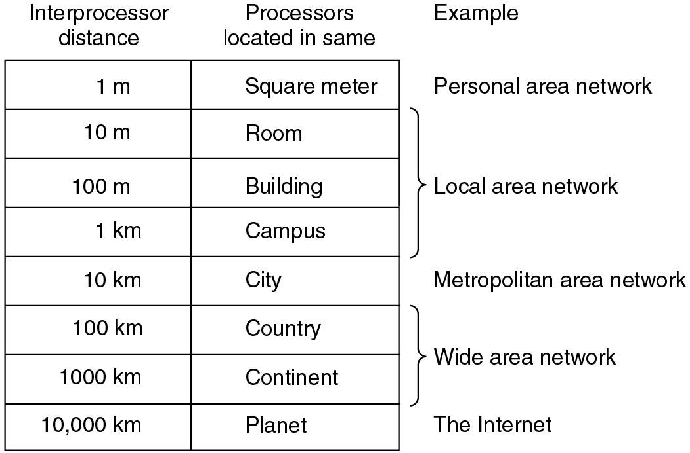
Broadcast Networks (2)
Classification of interconnected processors by scale.

Slide 3
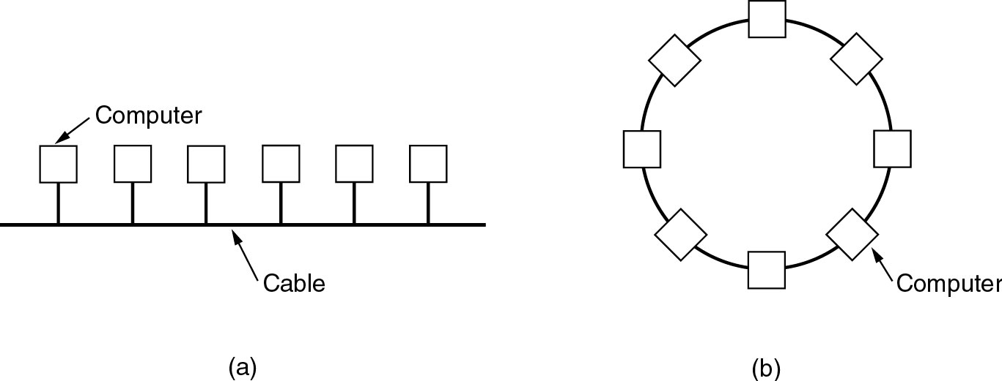
Local Area Networks
Two broadcast networks
(a) Bus
(b) Ring

Slide 4
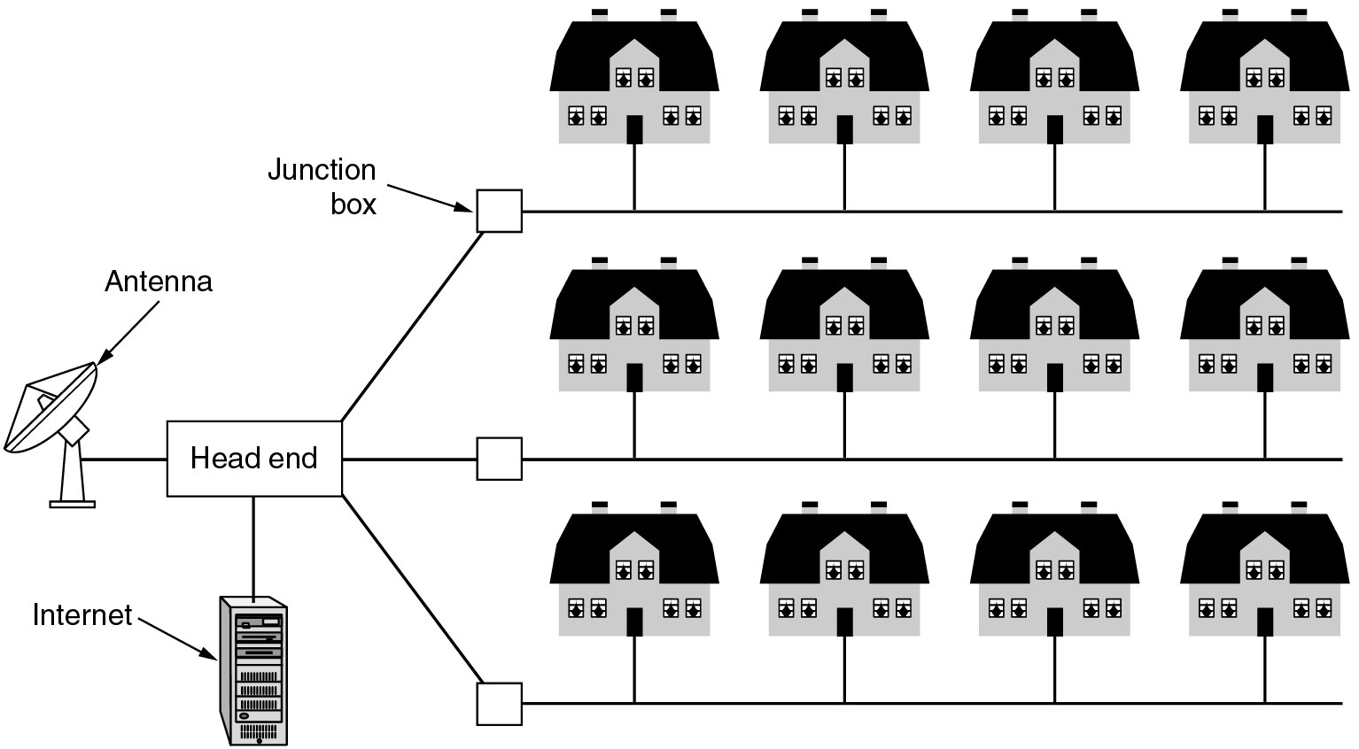
Metropolitan Area Networks
A metropolitan area network based on cable TV.

Slide 5
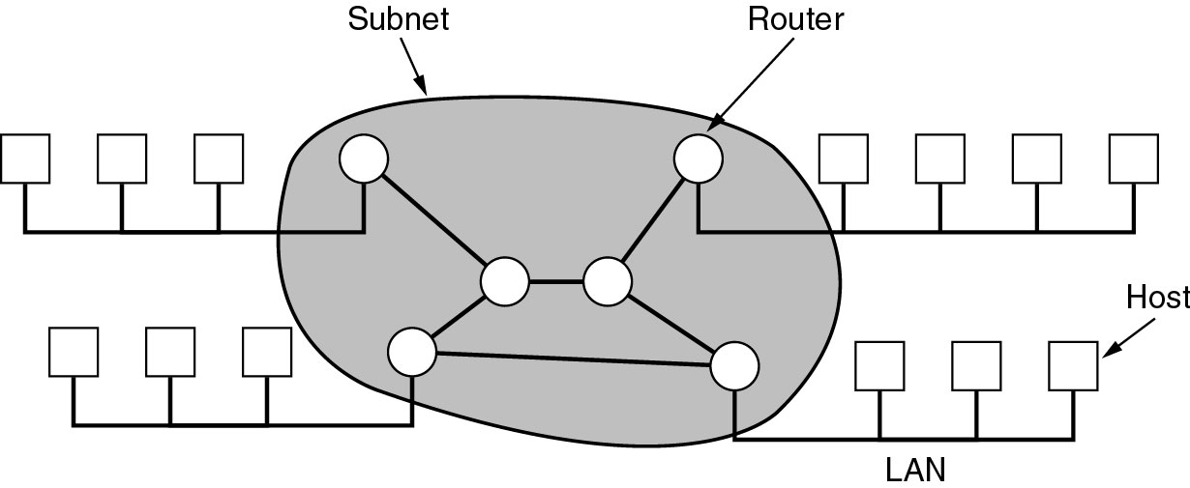
Wide Area Networks
Relation between hosts on LANs and the subnet.

Slide 6
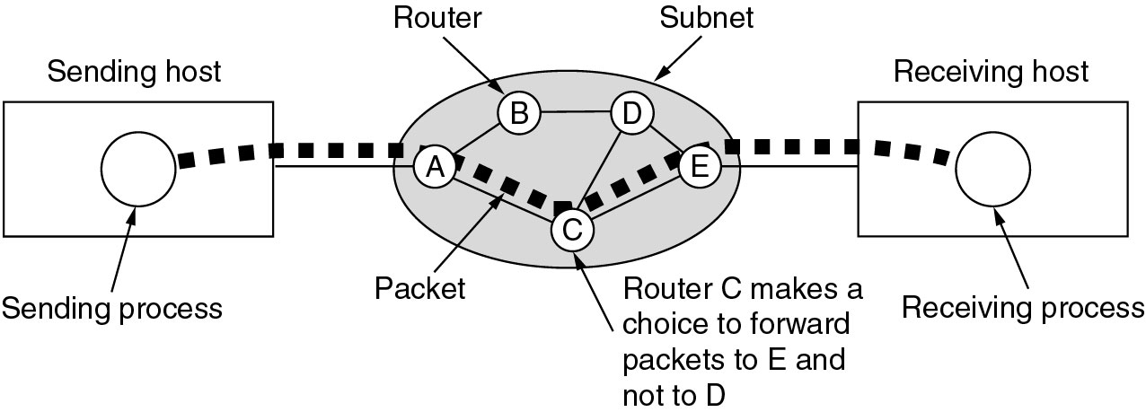
Wide Area Networks (2)
A stream of packets from sender to receiver.

Slide 7
Wireless Networks
Categories of wireless networks:
System interconnection
Wireless LANs
Wireless WANs

Slide 8
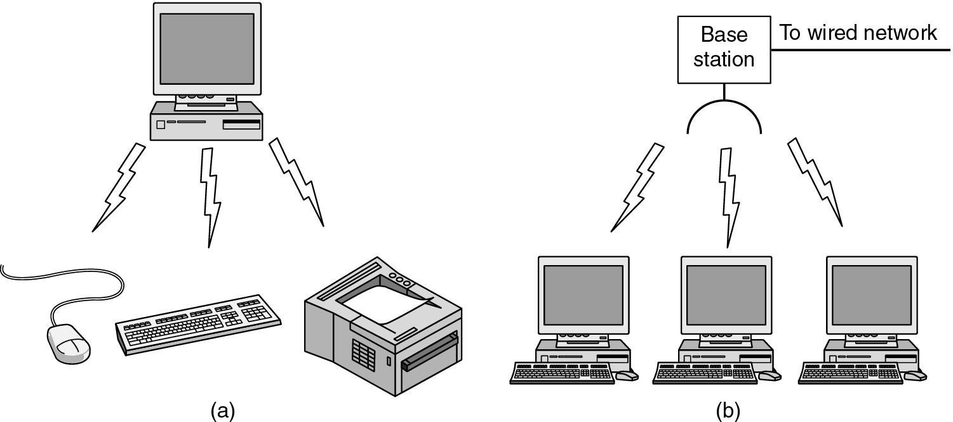
Wireless Networks (2)
(a) Bluetooth configuration
(b) Wireless LAN

Slide 9
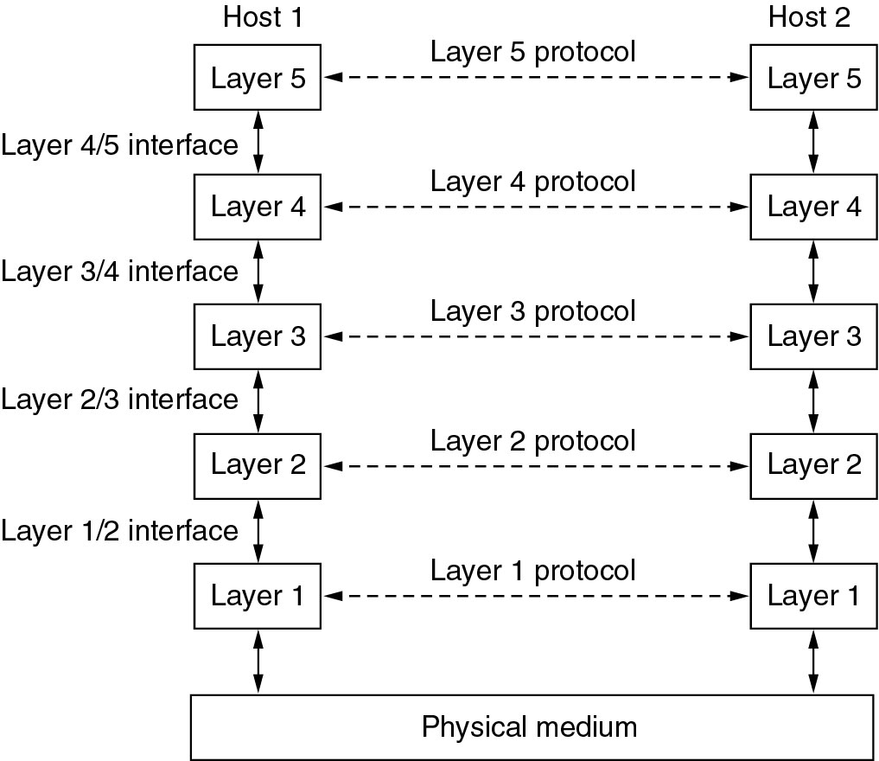
Network Software
Protocol Hierarchies
Layers, protocols, and interfaces.

Slide 10
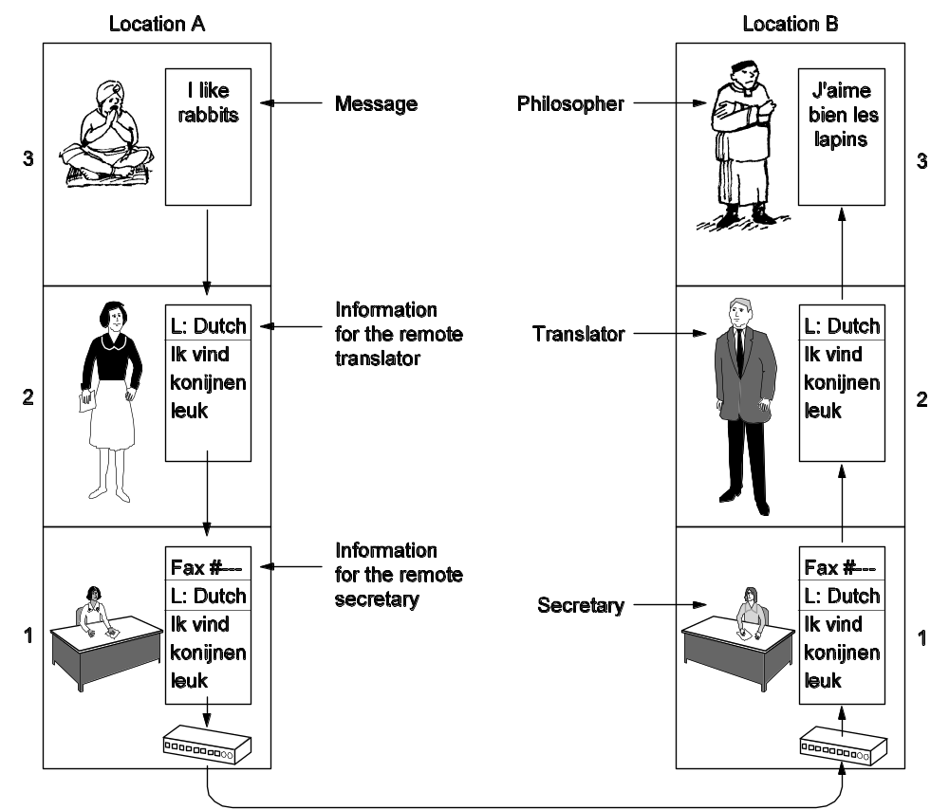
Protocol Hierarchies (2)
The philosopher-translator-secretary architecture.

Slide 11
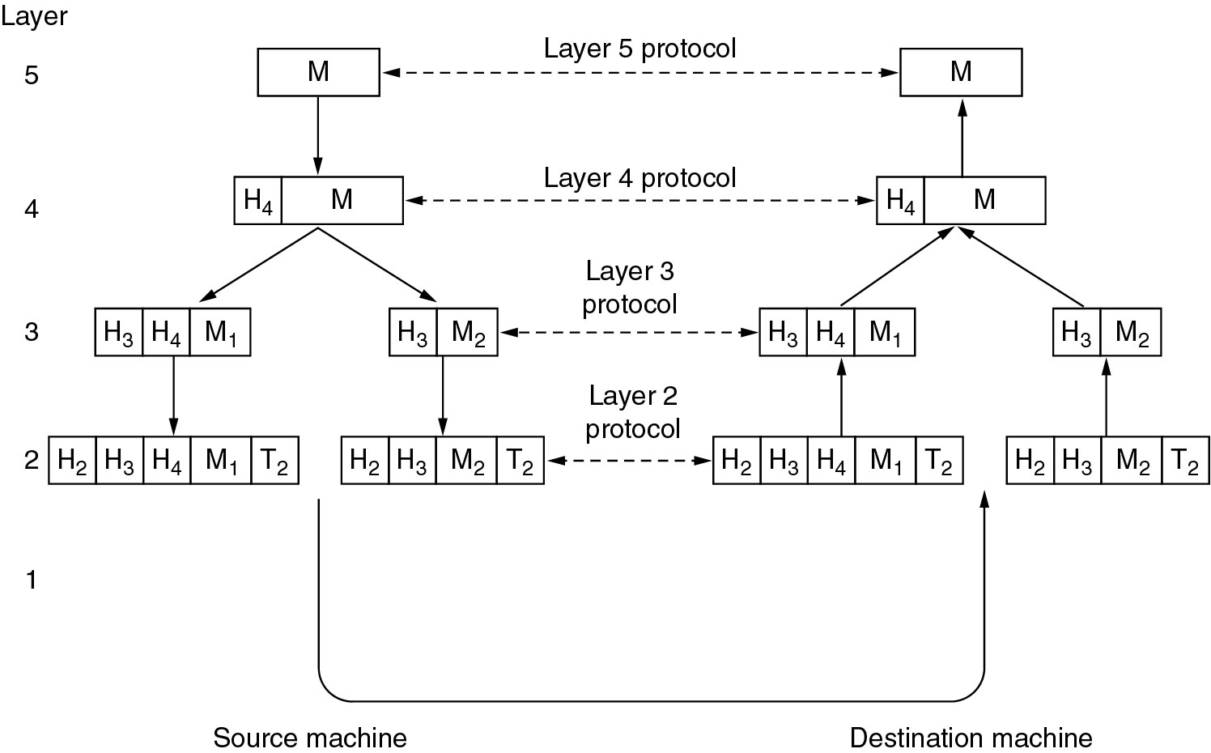
Protocol Hierarchies (3)
Example information flow supporting virtual communication in layer 5.

Slide 12
Design Issues for the Layers
Addressing
Error Control
Flow Control
Multiplexing
Routing

Slide 13
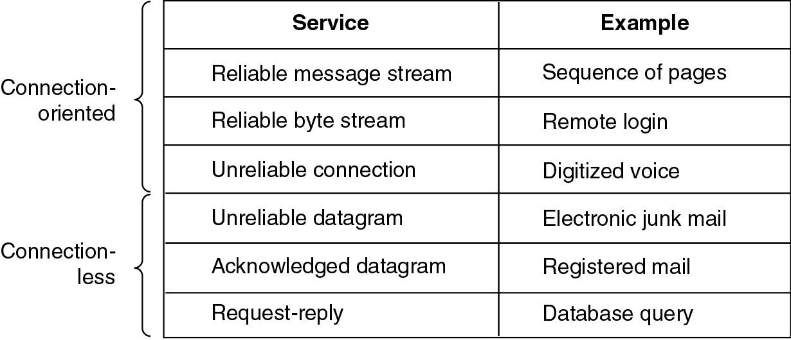
Connection-Oriented and Connectionless Services
Six different types of service.

Slide 14
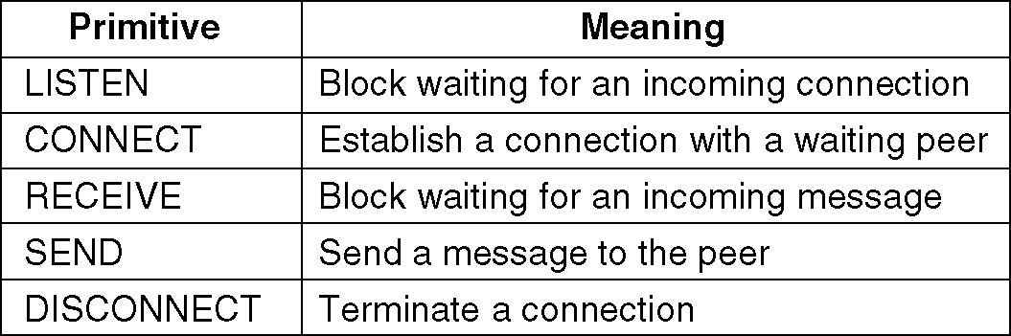
Service Primitives
Five service primitives for implementing a simple connection-oriented service.

Slide 15
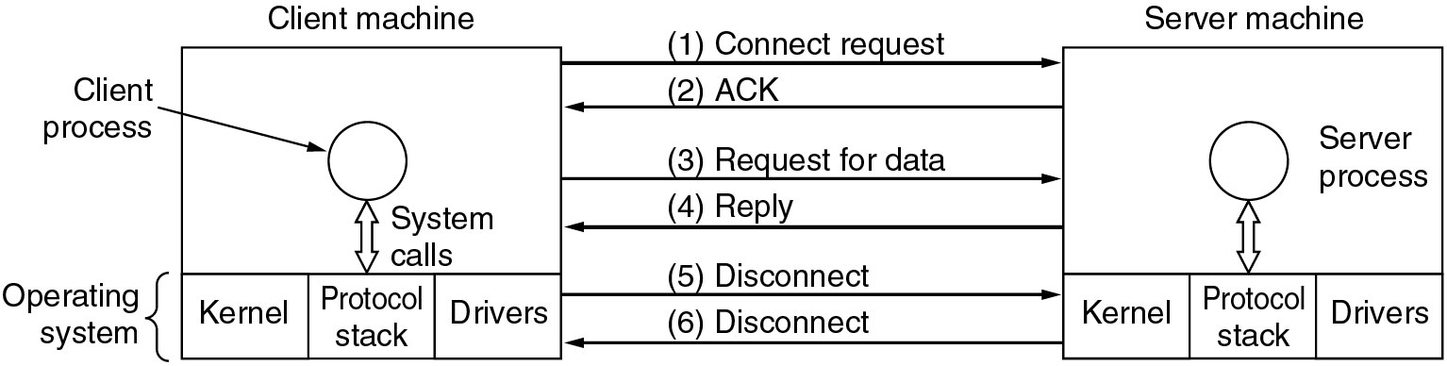
Service Primitives (2)
Packets sent in a simple client-server interaction on a connection-oriented network.

Slide 16
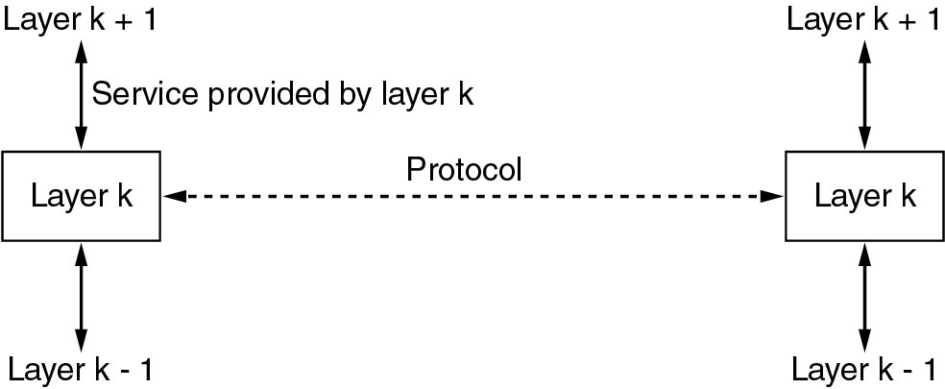
Services to Protocols Relationship
The relationship between a service and a protocol.

Slide 17
Reference Models
The OSI Reference Model
The TCP/IP Reference Model
A Comparison of OSI and TCP/IP
A Critique of the OSI Model and Protocols
A Critique of the TCP/IP Reference Model

Slide 18
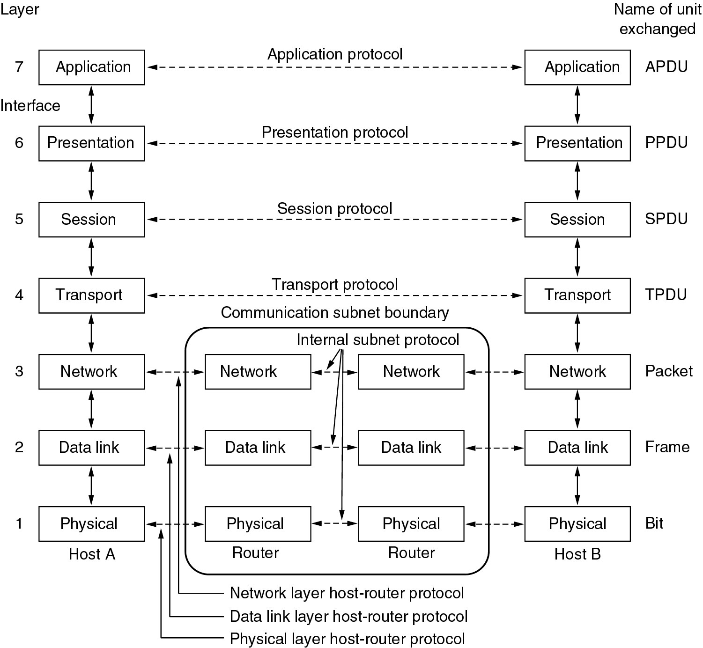
Reference Models
The OSI reference model.

Slide 19
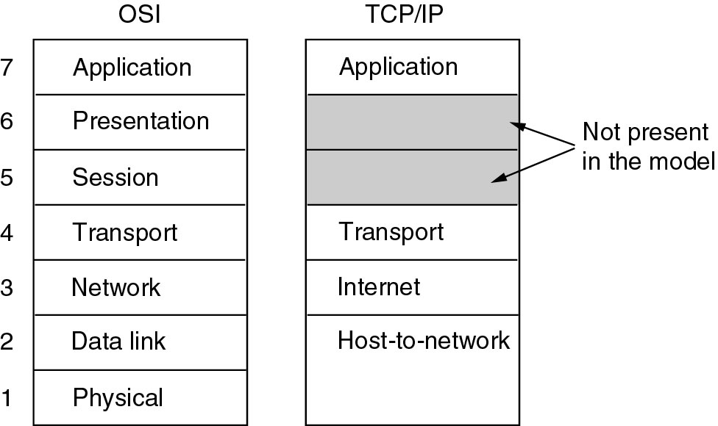
Reference Models (2)
The TCP/IP reference model.

Slide 20
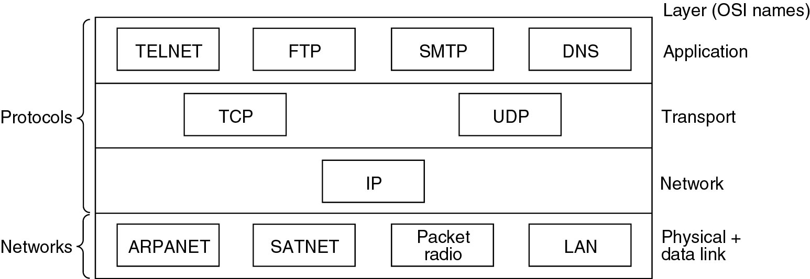
Reference Models (3)
Protocols and networks in the TCP/IP model initially.

Slide 21
Comparing OSI and TCP/IP Models
Concepts central to the OSI model
Services
Interfaces
Protocols

Slide 22
A Critique of the OSI Model and Protocols
Why OSI did not take over the world
Bad timing
Bad technology
Bad implementations
Bad politics

Slide 23
A Critique of the TCP/IP Reference Model
Problems:
Service, interface, and protocol not distinguished
Not a general model
Host-to-network “layer” not really a layer
No mention of physical and data link layers
Minor protocols deeply entrenched, hard to replace

Slide 24
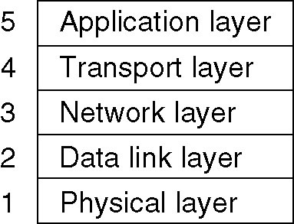
Hybrid Model
The hybrid reference model to be used in this book.

Slide 25
Example Networks
The Internet
Connection-Oriented Networks:
X.25, Frame Relay, and ATM
Ethernet
Wireless LANs: 802:11

Slide 26
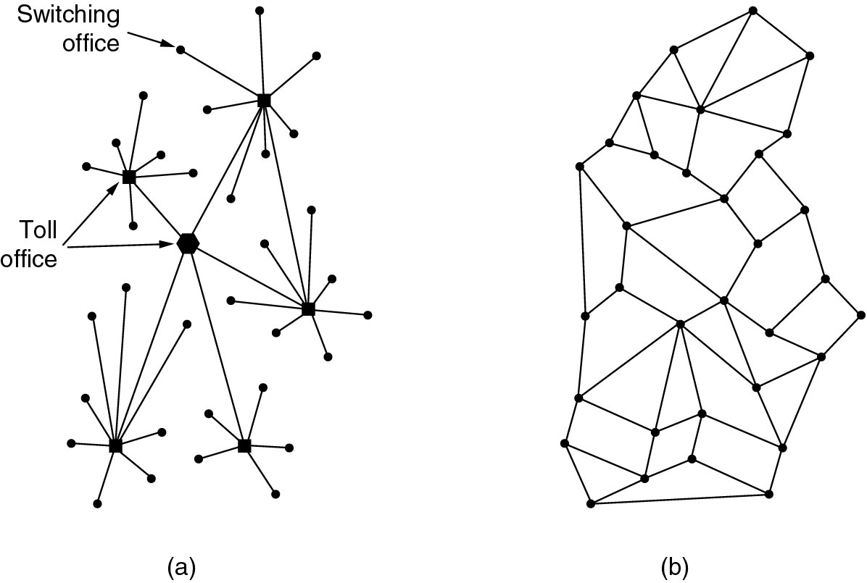
The ARPANET
(a) Structure of the telephone system.
(b) Baran’s proposed distributed switching system.

Slide 27
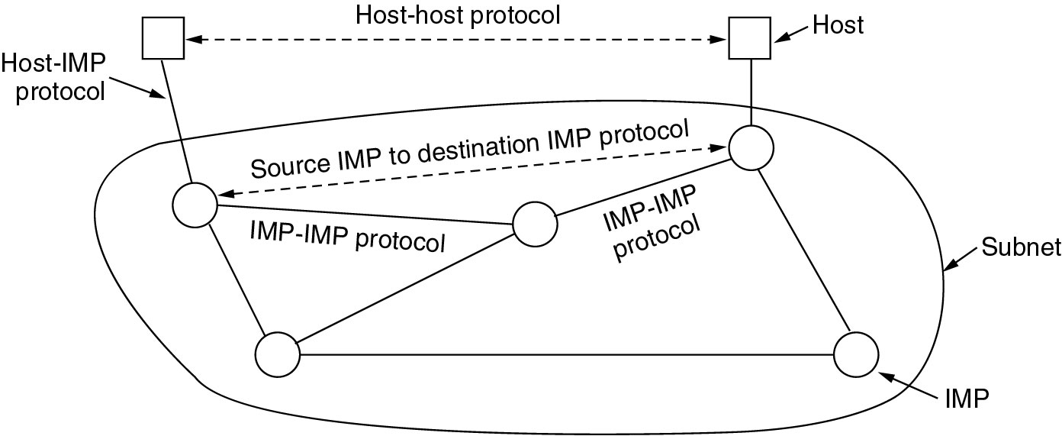
The ARPANET (2)
The original ARPANET design.

Slide 28
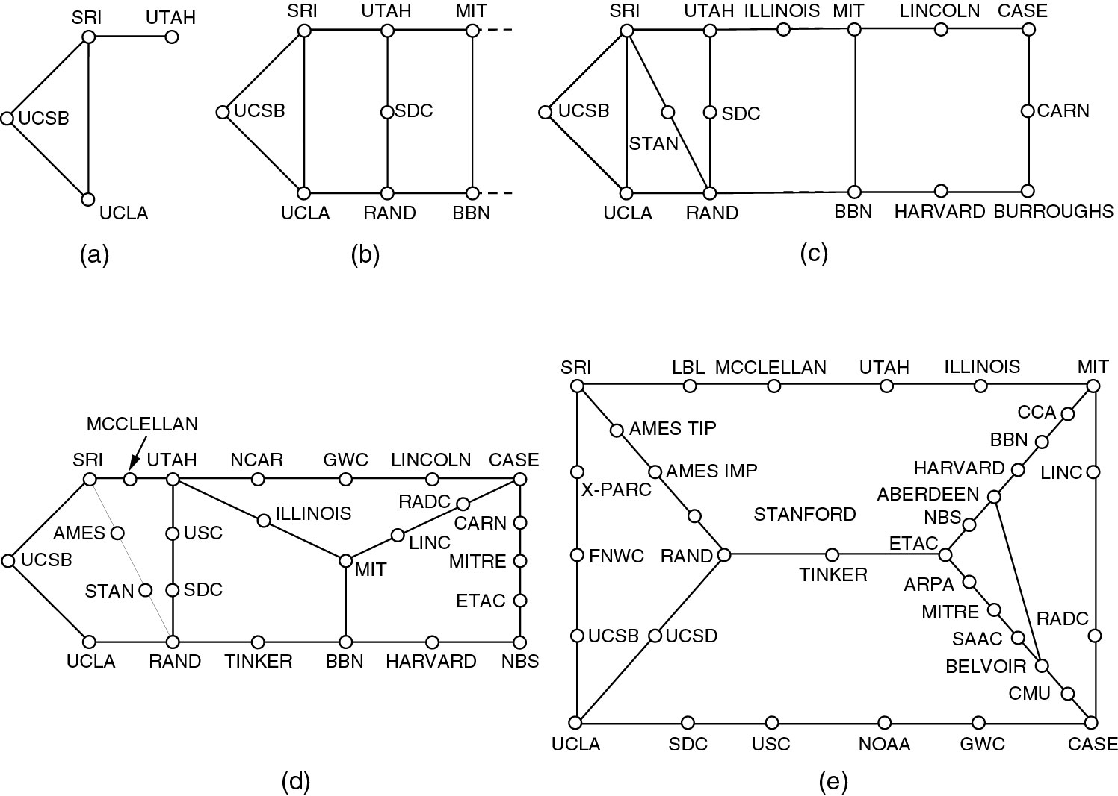
The ARPANET (3)
Growth of the ARPANET (a) December 1969. (b) July 1970.
(c) March 1971. (d) April 1972. (e) September 1972.

Slide 29
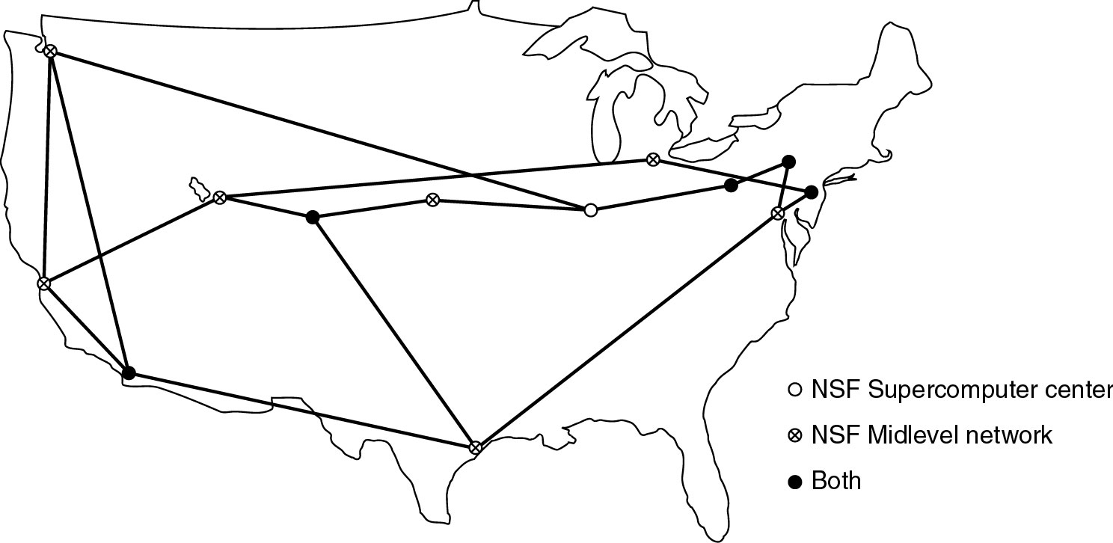
NSFNET
The NSFNET backbone in 1988.

Slide 30
Internet Usage
Traditional applications (1970 – 1990)
E-mail
News
Remote login
File transfer

Slide 31
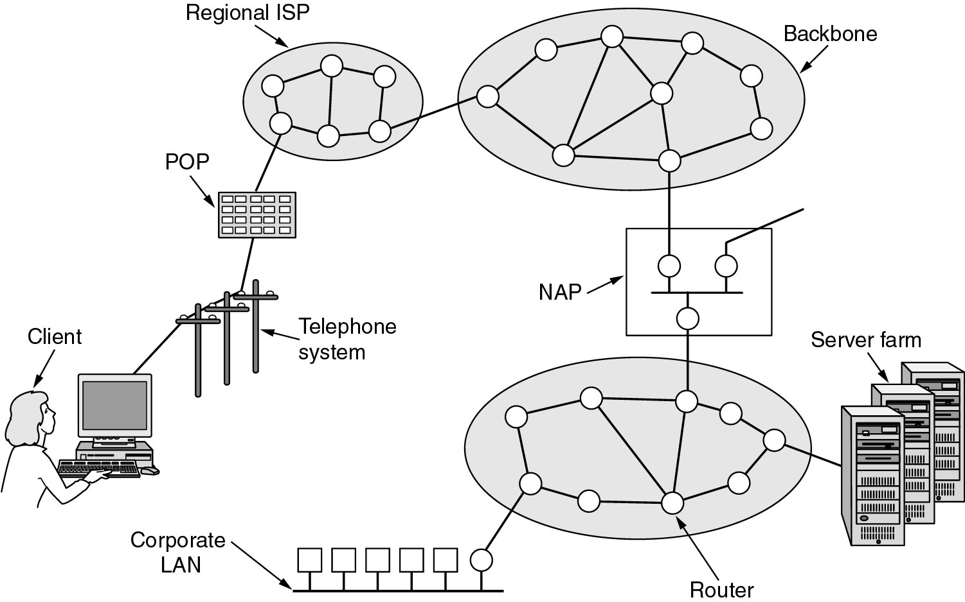
Architecture of the Internet
Overview of the Internet.

Slide 32
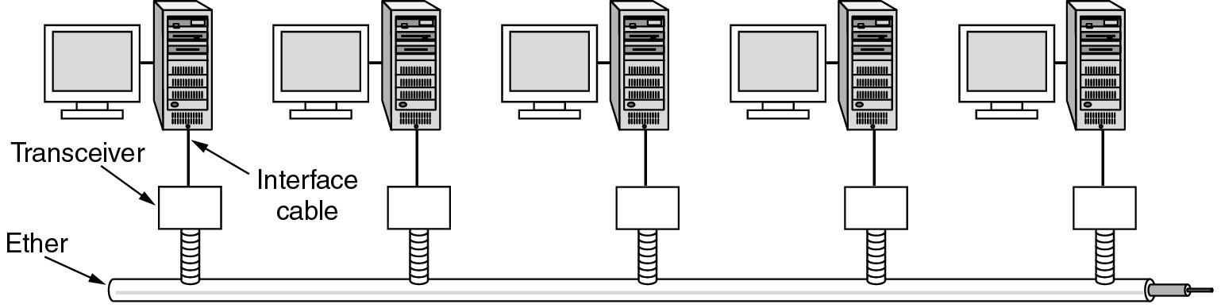
Ethernet
Architecture of the original Ethernet.

Slide 33
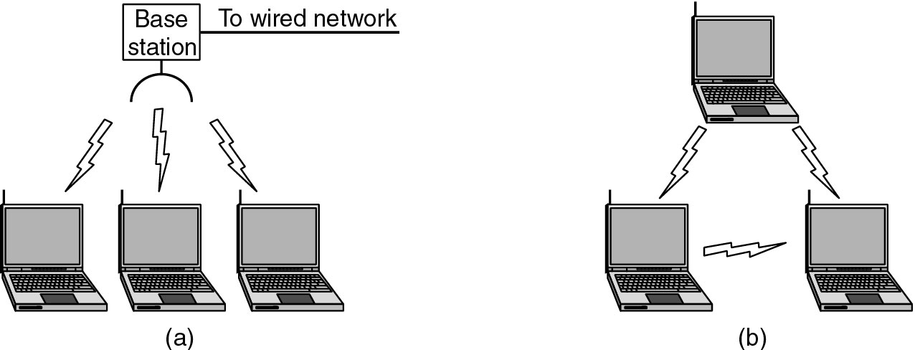
Wireless LANs
(a) Wireless networking with a base station.
(b) Ad hoc networking.

Slide 34
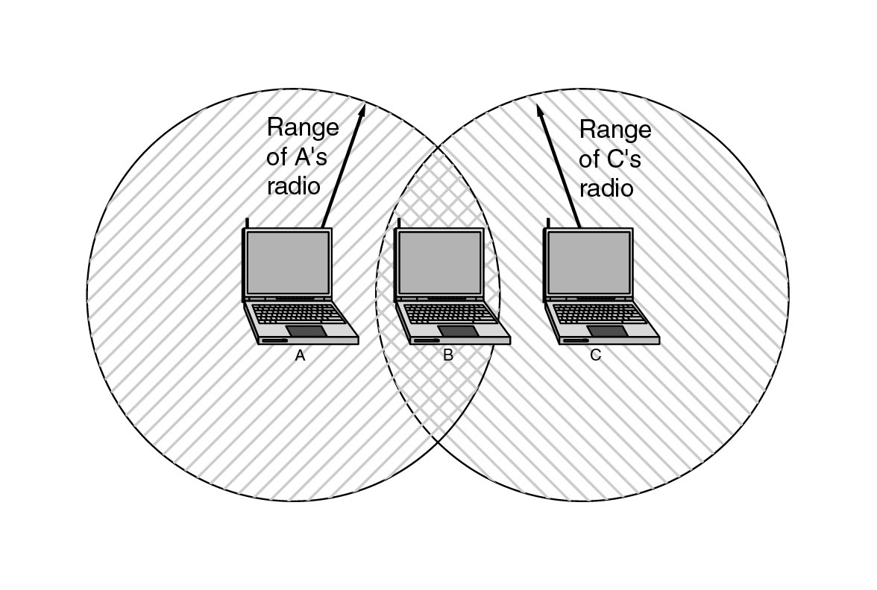
Wireless LANs (2)
The range of a single radio may not cover the entire system.

Slide 35
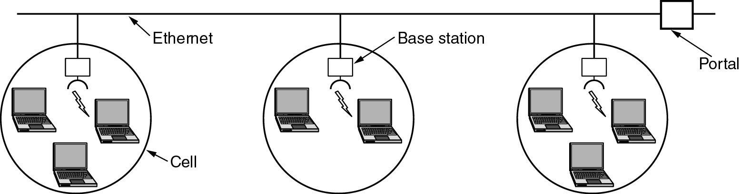
Wireless LANs (3)
A multicell 802.11 network.

Slide 36
Network Standardization
Who’s Who in the Telecommunications World
Who’s Who in the International Standards World
Who’s Who in the Internet Standards World

Slide 37
ITU
Main sectors
  Radiocommunications
  Telecommunications Standardization
  Development
Classes of Members
  National governments
  Sector members
  Associate members
  Regulatory agencies

Slide 38
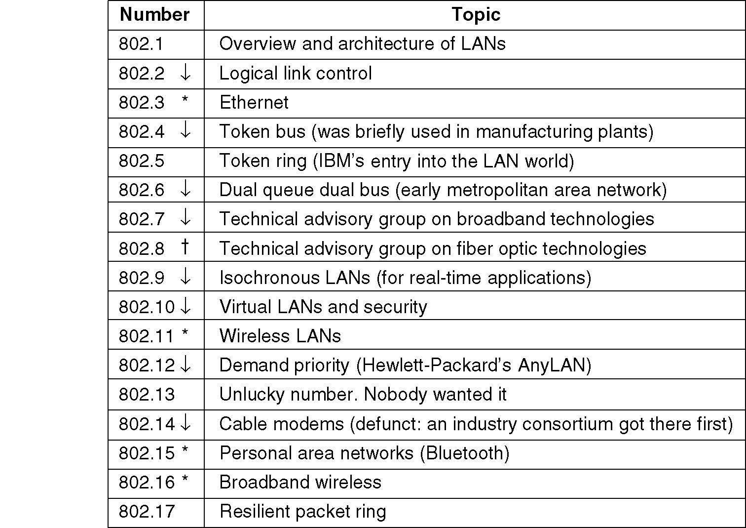
IEEE 802 Standards
The 802 working groups. The important ones are marked with *. The ones marked with ↓ are hibernating. The one marked with † gave up.

Slide 39
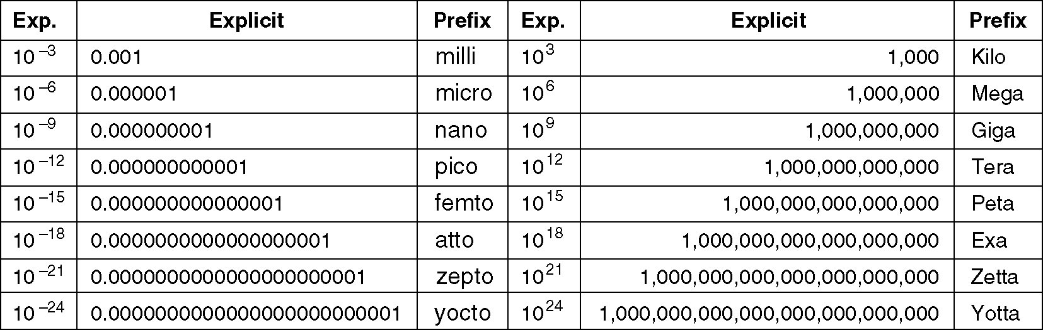
Metric Units
The principal metric prefixes.

